Slide 1
The Risk of Pneumonia in COVID-19 Patients based on Comorbidities
Data Analysis Final Project | S. Nooruddin & N. Rockwood
Notes:
[NATHANIA]
Good evening!
For the past few weeks, my groupmate, Shazia, and myself have been working on this project we present to you today. As you can see, we worked on this project as a 2-woman team, and hope to meet and exceed your expectations as all other teams that have more than 2 people.
The title of our project as you can see on the screen is the risk of pneumonia in COVID-19 Patients Based on Comorbidities.
I will go in detail as to why we chose this topic in the following slides…so let’s get started!

Slide 2
Table of Contents
Overview of Data
Project Overview
Project Methodology
Data Exploration, Analysis, & Results
Recommendations
Interactive Dashboard
The Risk of Pneumonia in COVID-19 Patients based on Comorbidities
Notes:
[NATHANIA]
For this presentation, we will go through the following points:
We will go through what this project is and why we chose the project
We will go through how we went about this project and how we put it together
What data we used, the analysis created, and the results we saw
We’ve also included some recommendations for future analyses, and what we would do differently
And lastly, I have included a recording of the dashboard, but it is published on Tableau public

Slide 3
Data Overview
Data Description
Data from the Mexican Government on COVID-19 patients
500k data points in initial dataset, 50k datapoints used
Data Columns
Patient ID | Date of Death | Diabetes | Cardio Disease | COVID Results
Sex | Intubated Patient | Pulmonary Disease | Obesity | In ICU
Patient Type | Pneumonia | Asthma | Renal Failure | Unknown Disease
Entry Date | Age | Hypertension | Tobacco | Other Diseases
Date Symptoms Started | Pregnant | Contact with Other COVID Patients
Notes:
I will start by describing the data that we have to give you a better understanding on what our project is about.
After a couple days of scrambling to find something useful, we landed on this dataset from Kaggle.
The data was obtained from the Mexican Government’s dataset on overpopulated hospitals with COVID patients
This dataset initially had over 500,000 data points, however after it was cleaned up, we narrowed it down to around 50,000
This data had around 23 columns, 19 of which were descriptions of the patients and other health conditions they had
This dataset also had data mentioning if the subjects were COVID positive or COVID negative patients

Slide 4
Project Overview & Team Objective
Based on our downloaded dataset, we hoped to answer the question whether or not patients that get admitted to hospitals can get pneumonia based on various factors presented in the dataset
We have used a supervised machine learning model to determine the likelihood of patients catching pneumonia.
Notes:
[NATHANIA]
From the data that we found, we were able to come up with a hypothesis that we thought we could prove and drive results from
Since COVID is still unfortunately relevant, we thought this would be an interesting topic.
We hoped to answer the questions: “Can patients get pneumonia based on X? Their age? The duration from which they felt their symptoms and when they were first admitted? Or will their past respiratory diseases dictate the likelihood of the patients catching pneumonia?”
As these questions arose, we decided a supervised machine learning model would best help us determine the likelihood of patients catching pneumonia.

Slide 5
Methodology
Tracking group progress through Google Slides
Tracking project progress through GitHub Repository
Group Dynamic
Finding a reliable and useful dataset
Cleaning dates and removing null values
Basic computation for date durations
Combining data using SQL queries and pgAdmin Database
Data Gathering
& Cleaning
Supervised Machine Learning Model and Algorithms
Interactive Dashboard
Analysis
Notes:
[NATHANIA]
I will now walk you through the “how”
As I mentioned earlier, we were a small group as we started. It may have made the first part of the project a little difficult trying to hustle which roles each person was going to play, but we managed.
We used Google Slides to track our progress and assign each other what needed to be done
We agreed that I’d be in charge of logistics and managing the project while Shazia was leading most of the coding and analysis aspect of the project
With the use of our GitHub repository, my team was successful in tracking progress throughout this whole project
In the early stages, we tried to gather as much data as we could find
We explored as many resources as we could—scrambling Kaggle datasets, government data that was accessible, and relying on Google to tell us what it had on COVID 19 cases
When we finally found the data that we judged would suit our needs, we cleaned it up. Some dates were a bit funky and some data we just didn’t need.
We only kept the necessary data we needed for the analysis
Part of the cleaning, and after the dates were cleaned, we computed the duration from when the patients were admitted into the hospital to when they started feeling symptoms.
We then combined the larger dataset with the computed data using SQL queries and our pgAdmin database
And lastly, the final analysis was conducted using Supervised Machine Learning and multiple algorithms which Shazia will go through in the slides further into this presentation.
I have also included a recording at the end of this presentation of our interactive dashboard for our data.
I will now hand over the floor to Shazia to go over the data and analysis portion of the project.

Slide 6
Data Exploration
1
Replacing all unknown objects with NaN
Value Counts
2
Primary Key = Index
35,505
3
Dropped the following columns:
ID, Date Died, and Pregnancy
Patients with pneumonia
4
Dropped rows with NaN Objects
15,869
5
Created column entry_date_minus_date_symptoms
Patients without pneumonia
6
Moved ‘pneumonia’ column to the end
Notes:
[SHAZIA]
Created column entry_date_minus_date_symptoms, which represents the number of days the patient had symptoms before being admitted into the hospital, and converted it to days with the data type ‘integer’ for use in our modeling.
We moved the pneumonia column to the end so that it would be easier to use when assigning ranges to x and y variables.
We checked the value counts and ensured those with and without pneumonia were balanced.

Slide 7
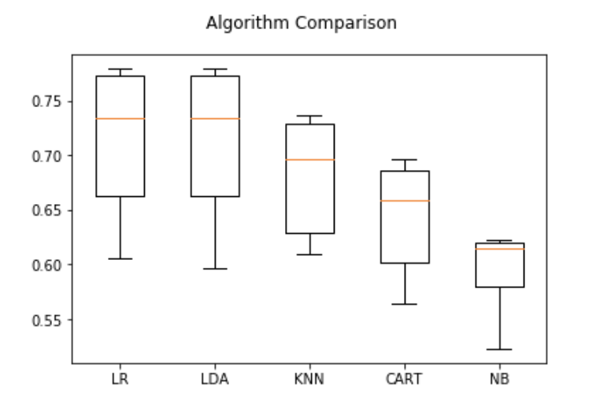
Data Analysis: Supervised Modeling
x
y
Pneumonia
All columns excluding pneumonia
Cross validation accuracy score (standard deviation)
Logistic Regression: 0.7146 (0.06)
Linear Discriminant Analysis: 0.7138 (0.06)
K Nearest Neighbor Classifier: 0.6809 (0.05)
Decision Tree Classifier: 0.642150 (0.05)
Gaussian Naive Bayes: 0.5973 (0.03)
Figure 1. This figure compares the accuracy scores of the supervised models through a box and whisker plot, with logistic regression having the greatest accuracy score.
Notes:
[SHAZIA]
The independent variables for these models were all columns excluding the index and pneumonia. The dependent variable was pneumonia. Below are the cross validation accuracy scores with their respective standard deviations for each model. As you can see, logistic regression had the greatest accuracy score, making it the ideal model for this dataset.

Slide 8
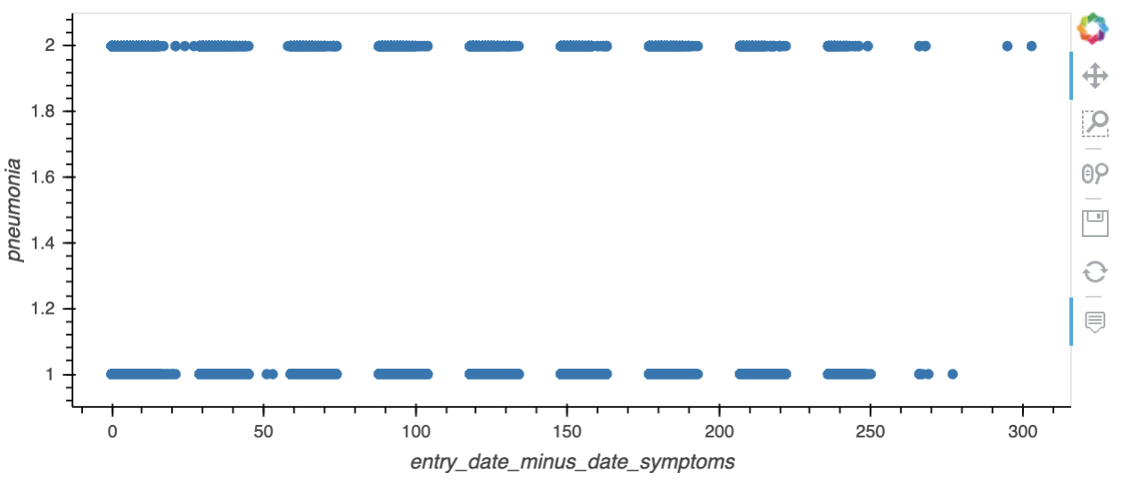
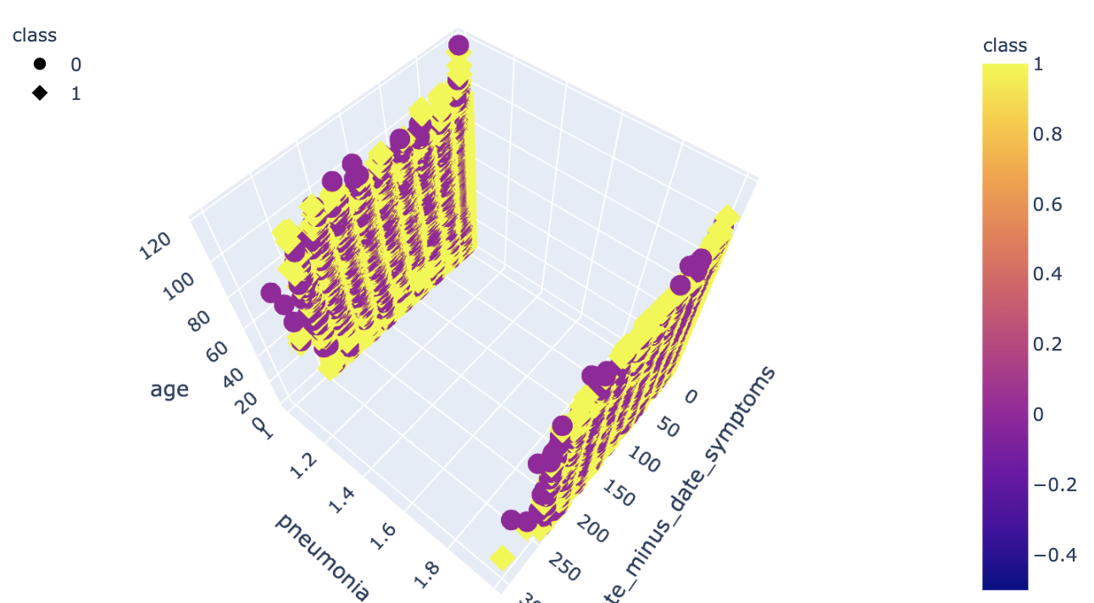
Data Analysis: Unsupervised Modeling
Figure 2. This figure compares the variable entry_date_minus_date_symptoms, which represents the number of days the coronavirus patient had symptoms before being admitted into the hospital, with the incidence of pneumonia through an unsupervised machine learning model.
Figure 3. This figure depicts entry_date_minus_date_symptoms vs. pneumonia vs. age in a 3-Dimensional graph, revealing no clear conclusion as the data is evenly distributed across variables.
Notes:
[SHAZIA]
When plotting different variables against each other, we noticed that because most variables are binary and since they had even distributions among variables, the plots did not have clear clusters from which to analyze. Entry_date_minus_date_symptoms was evenly distributed among pneumonia outcome. Even after fitting for the most accurate number of clusters using an elbow plot, applying it to a K-Means model still did not show clear results, as seen from the 3D plot of entry_date_minus_date_symptoms vs pneumonia vs age.

Slide 9
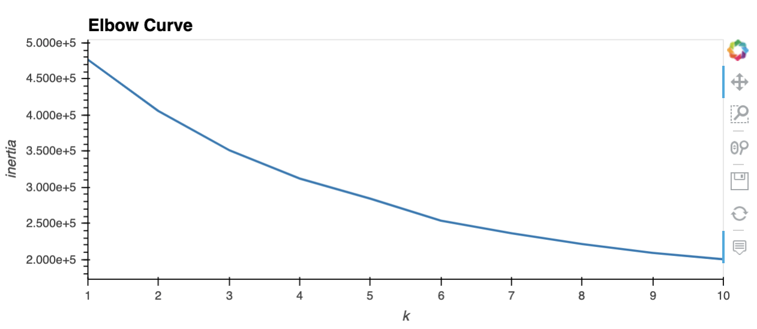
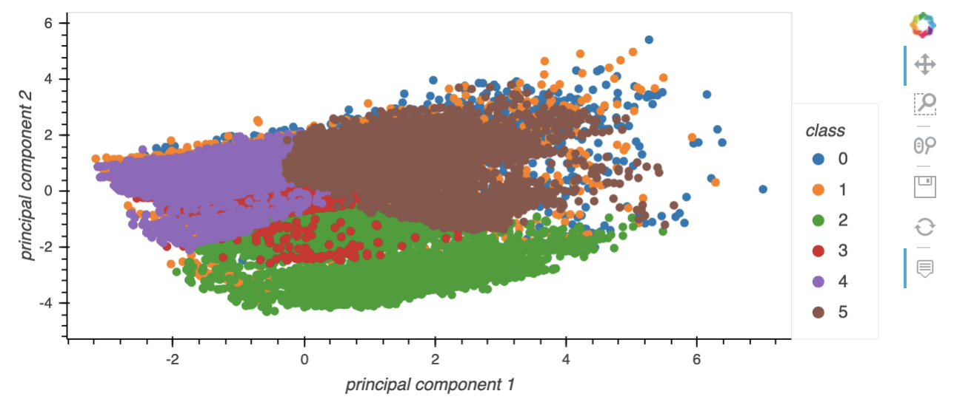
Data Analysis: PCA
Figure 4. This figure portrays the step in PCA analysis where we found the appropriate value of K, 6, for use in the K-means model based on the value of inertia.
Figure 5. This figure shows an example of an ambiguous plot comparing principal components 1 and 2 together based on nine classes.
Notes:
[SHAZIA]
First, we standardized objects in the data frame using StandardScalar.
Then, we initialized the PCA model using the transformed data.
We added more principal components until the sum of the explained variance ratio equaled above 50%.
We calculated the inertia for a range of K values and found the appropriate number using the elbow curve.
We initialized the K-means model, fit the model, predicted the number of clusters, and plotted principal components against each other.
We then used sklearn's train_test_split function on the data with all columns except pneumonia for x and pneumonia for y.
We transformed the training and testing groups with PCA and analyzed them with logistic regression.
The accuracy score turned out to be 0.6946, which is less than that of the supervised machine learning logistic regression model.

Slide 10
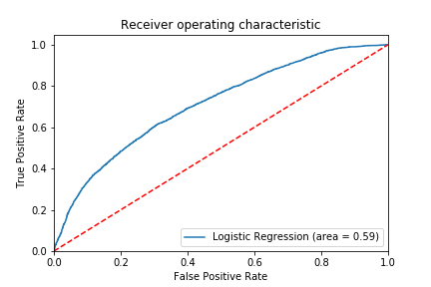
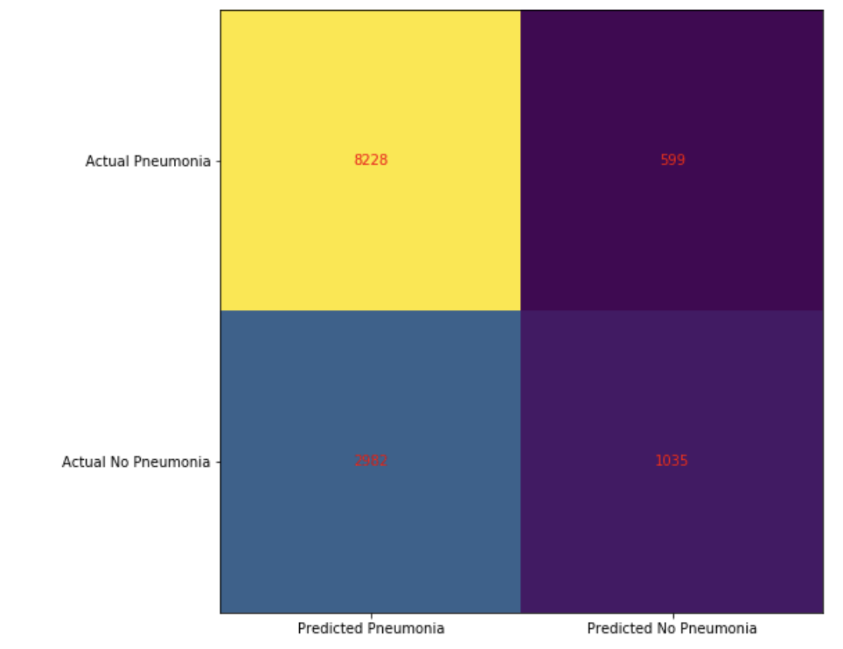
Analysis Results
8228
599
2982
1035
Figure 6. This figure depicts the ROC (receiver operating characteristic) curve for the supervised machine learning logistic regression model, with an area under the curve of 0.59.
Figure 7. This figure illustrates the confusion matrix based on the logistic regression model.
Notes:
[SHAZIA]
The ROC curve (receiver operating characteristic curve) is a graph showing the performance of the classification model at all classification thresholds. With two parameters, the True Positive Rate and the False Positive Rate. AUC stands for "Area under the ROC Curve" and measures the entire two-dimensional area underneath the entire ROC curve, which, in this case, is 0.59. 0.59 is the probability that the supervised machine learning logistic regression model ranks a random positive example more highly than a random negative example.
The confusion matrix is the table of true positives, false positives, true negatives, and false negatives from the application of the logistic regression model on the data set when predicting the incidence of pneumonia in patients with COVID-19.

Slide 11
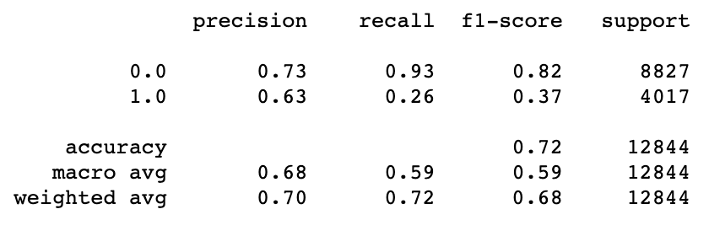
Classification Report
Figure 8. This figure reveals the classification report for the supervised machine learning model of logistic regression, with 0 indicating a patient not having pneumonia and 1 indicating that the patient did have pneumonia. A feature of the report includes an accuracy score of 0.72.
Notes:
[SHAZIA]
And finally, the classification report shows the precision for prediction of no pneumonia and pneumonia are slightly misaligned with each other.
However, the recall (sensitivity) for predicting pneumonia is much lower than it is for predicting an absence of pneumonia.
The lower recall for pneumonia is reflected in the dropped F1 score as well. Recall for those with pneumonia is low, which is indicative of a large number of false negatives.
However, the accuracy score is relatively high, with a score of 0.72.

Slide 12
RECOMMENDATIONS
Find data from other countries that had additional attributes to compare or if they had the same related to pneumonia, what other factors may have caused it
Find data with a reliable source to draw accurate conclusions since there is a lot of disinformation with COVID-19 data available
Repeat analysis with supervised, unsupervised, and PCA transformed machine learning models in the future when data is more readily available since COVID-19 is new
Notes:
[NATHANIA]
And with that, our analysis is completed, and we have come up with a couple recommendations for further analysis.
Some of our recommendations include finding other reliable data sources from other countries that that the same or additional attributes to compare and contrast
Having a reliable source of data would also mean that we could draw more accurate conclusions. The problem with our data is that COVID-19 data is new and it can be misinformed at this early state. Doing this study at a later date in time (if and when COVID ends), may be able to tell us a different and more accurate story.

Slide 13
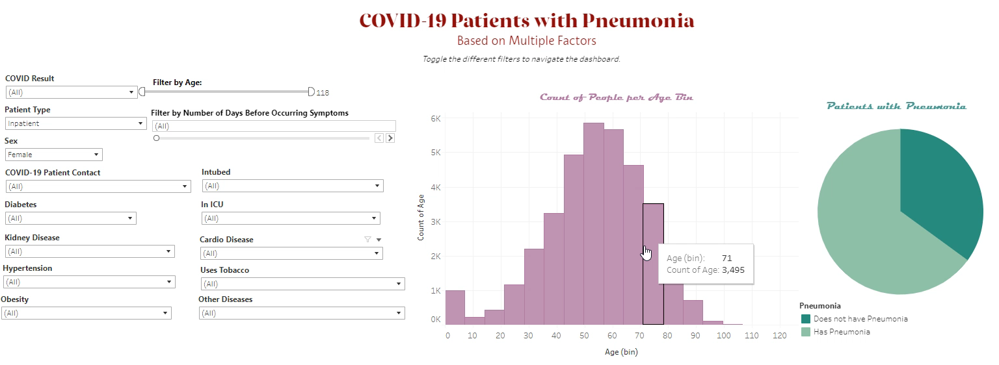
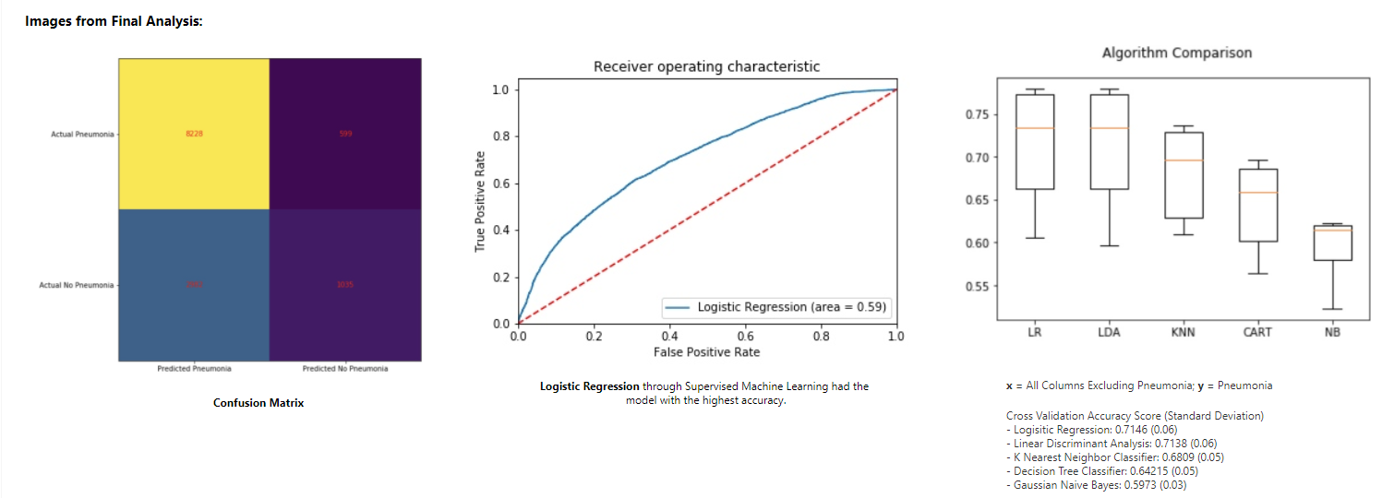
Interactive Dashboard
Notes:
[NATHANIA]
This is a video recording or our dashboard where you can click through the different variables of the dataset

Slide 14


Thank you!
https://github.com/TeamJupyter/COVID19
https://public.tableau.com/profile/nathania.rockwood#!/vizhome/COVID-19FinalProjectDashboard/Dashboard2?publish=yes
Notes:
[NATHANIA]
On that note, thank you for giving us the opportunity to present this project to you. If you’d like to go through our project in more detail, this is the link to the GitHub repository and the link to the dashboard.
Any questions/comments/feedback?

